Slide 1
GPT
Generative pretrained undirectional Decoder-only Transformer
OpenAI

Slide 2
GPT series: fine-tune and scale up
GPT-1: Improving Language Understanding by Generative Pre-training
GPT-2: Language Models are unsupervised multitask learners
GPT-3: Language models are few shot learners
GPT-3.5: Training language models to follow instructions with human feedback
ChatGPT
GPT-4: GPT-4 Technical Report

Slide 3
GPT models comparison
T: trillion 10¹² B: billion 10⁹ M: million 10⁶
human brain: 100B neurons and 100T synapses
features/model | GPT-4 | GPT-3.5 /InstructGPT | GPT-3 | GPT-2 | GPT-1 | BERT
feature | multimodal | RLHF | Few-shot learning | zero-shot learning | Generative pretrained | Contextualized word embedding
parameters | 100T | 1.3B | 175B | 1.5B | 117M | 340M
year | 2023 | 2022 | 2020 | 2019 | 2018 | 2018
storage |  |  | 800GB | 6.5 GB |  | 1.2GB
corpus |  |  | 600GB Common Crawl, WebText2, Books1, Books2 and Wikipedia. | 40GB WebText (Reddit posts with at least 3 upvotes) | 5GB Book Corpus | 16GB
context token size | 32768/8192 | 4096 | 2048 | 1024 | 512 | 512
word embedding size |  |  | 12288 | 1600 | 768 | 1024
depth |  |  | 96 | 48 | 12
Attention heads |  |  | 96 | 12 | 12
capacity | Image to text | Question answering | Write code, write articles |  | Classification, translation | Classification, sentiment analysis

Slide 4
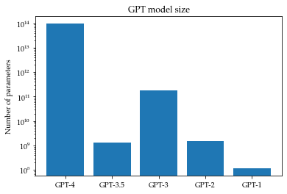
model size

Slide 5
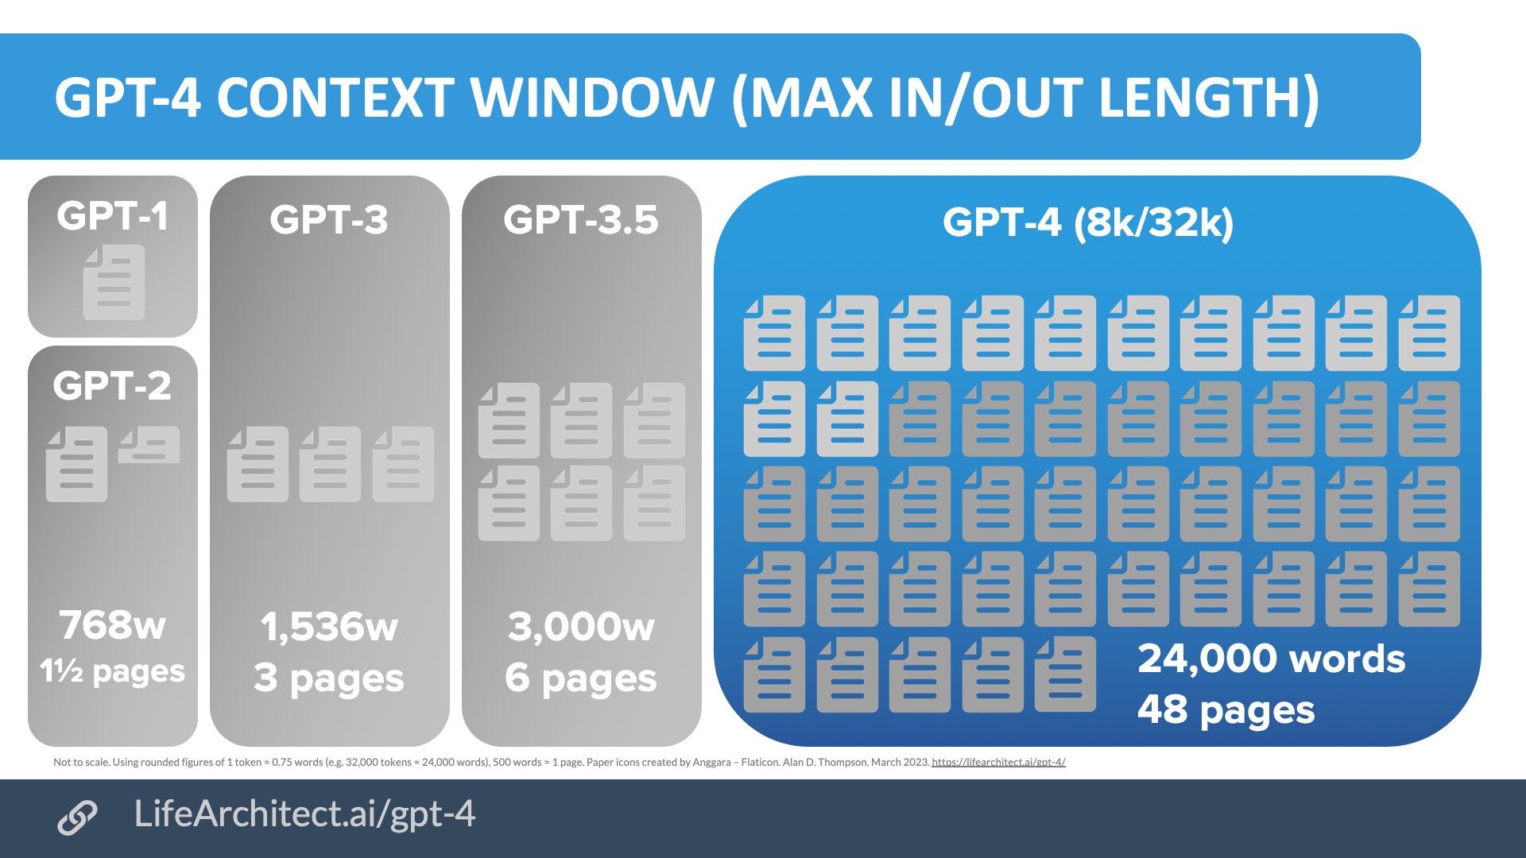
context window

Slide 6
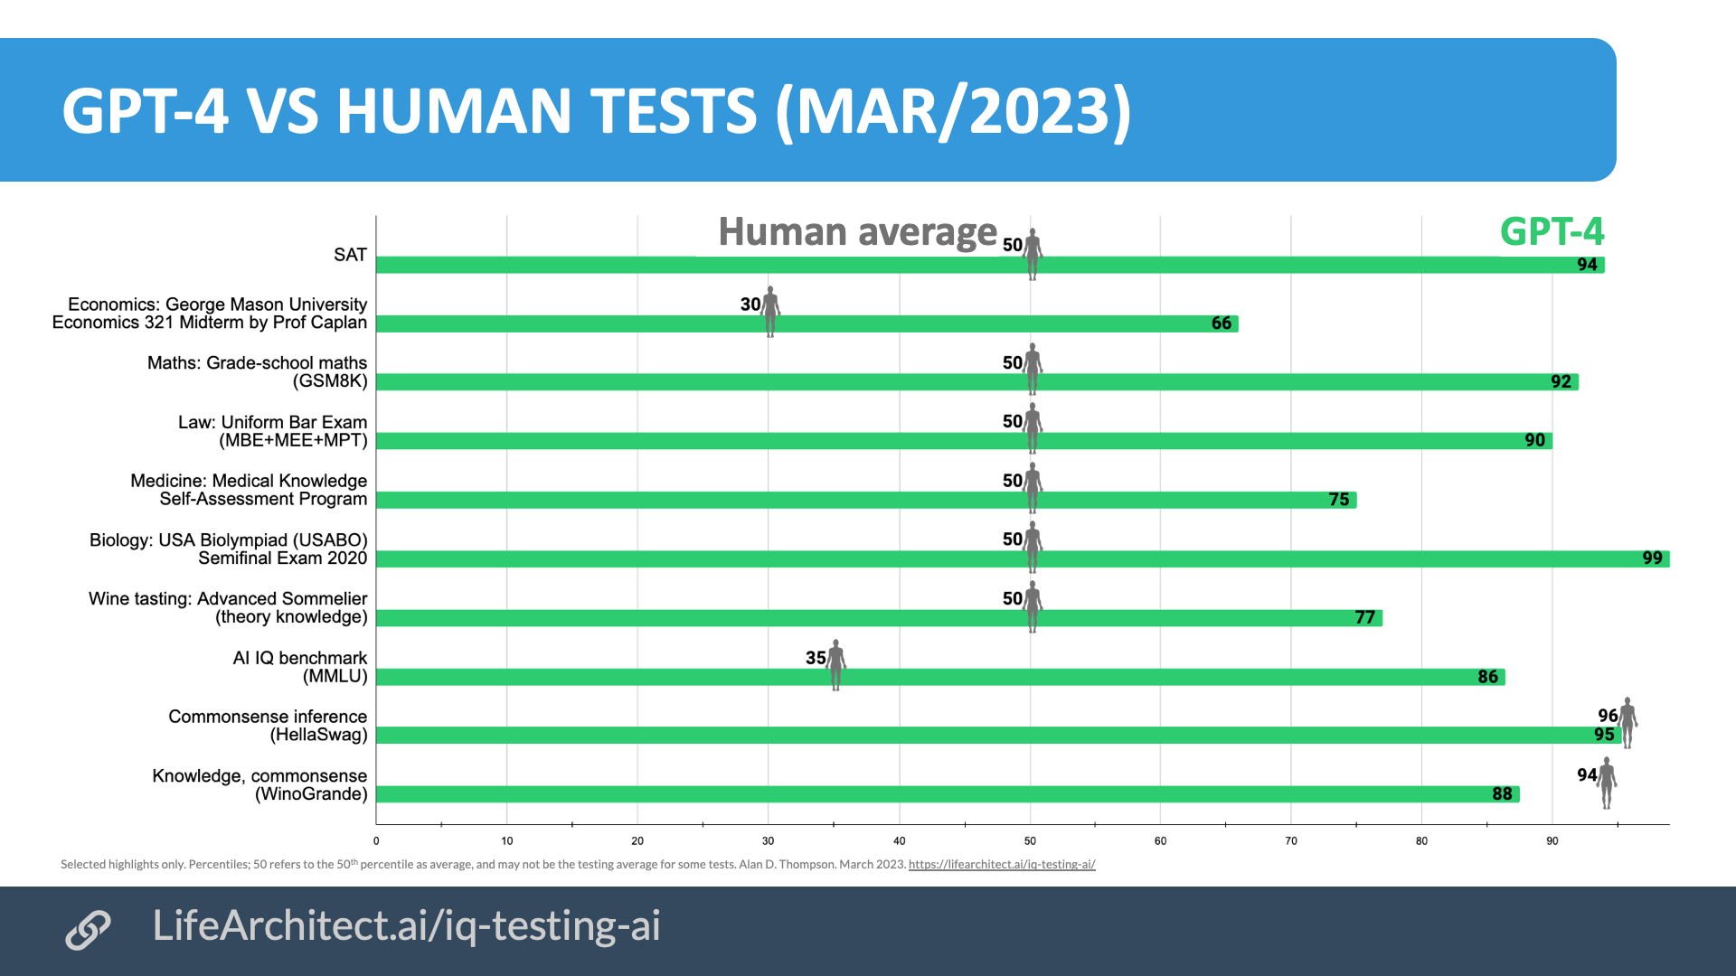
capacity

Slide 7
GPT vs. Transformer
remove encoder part of Transformer
GPT task is language modeling, the modified decoder architecture is sufficient for that
Transformer was designed for sequence-to-sequence tasks beyond language modeling
2 step Semi-supervised learning: unsupervised pre-training on language modelling + supervised fine-tuning on specific task
Layer Normalization:
Transformer: layer normalization after the residual connection
GPT: layer normalization before the residual connection. improved convergence during training.
Unified Input Representation for different tasks:
The model processes the input as a single sequence of tokens, including both input text and target text (if available), separated by a special delimiter token
e.g., <|endoftext|>

Slide 8

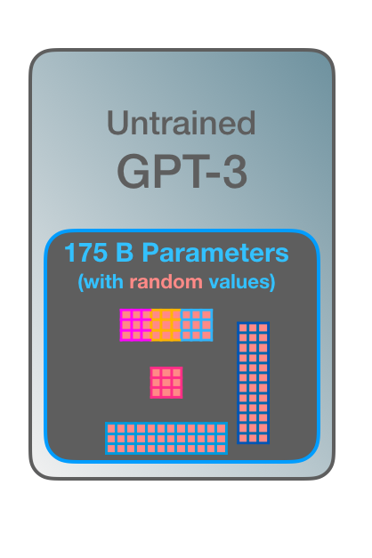
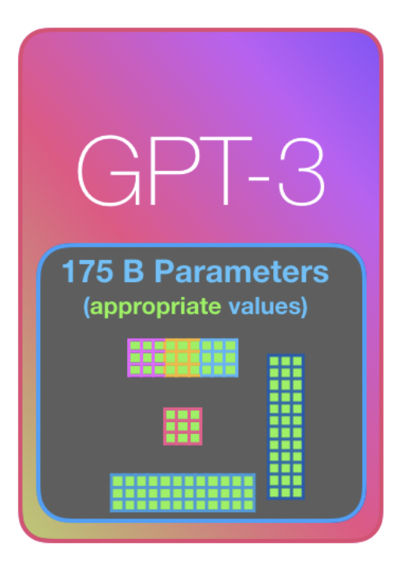
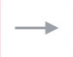
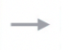
Semi-supervised learning: unsupervised pre-training on language modelling + supervised fine-tuning on specific task
pretrained
cheap large Unlabelled data
build on general language understanding
expensive small Labelled data
build on generalization on specific task
Notes:
GPT introduces a two-step approach for training the model.
It first undergoes unsupervised pre-training on a large corpus of text using a language modeling objective.
Then, the model is fine-tuned on specific supervised tasks with smaller labeled datasets.
This enables GPT to leverage the knowledge it has learned during pre-training and adapt to various NLP tasks with fewer labeled examples.

Slide 9
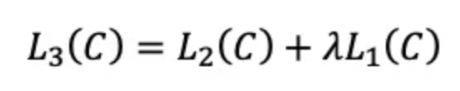
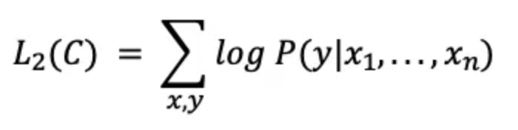
objective
L1: objective of language modelling: predict next token given a sequence of tokens
L2: objective of supervised fine-tuning: predict label given a sequence of tokens

Slide 10
Transfer learning
Transfer learning: store knowledge gained while solving one problem and apply it to a different but related problem. userful f when data of task is limited.
methods
pre-training -> fine-tuning
in-context adaptation
Zero-shot : no example
One-shot: one example
Few-shot: few examples
multi-task learning
domain adaptation
knowledge distillation
Notes:
in-context adaptation (few-shot transfer/meta-learning): model can perform a task with instruction and few to no training example.Fine tuning without weight updates
Multi-task Learning: Train a single model on multiple related tasks simultaneously, sharing some or all of the layers between the tasks. This allows the model to learn a shared representation that can generalize better to new tasks.
Domain Adaptation: Adjust the pre-trained model to work with a new domain, such as adapting a model trained on one language to work with another language, or adjusting a model trained on synthetic data to work with real-world data.
Knowledge Distillation: Train a smaller or more efficient model (student) to mimic the behavior of a larger or more complex model (teacher) by using the teacher's outputs as "soft targets" for the student model during training.

Slide 11
Downstream task
Classification
Sentiment analysis
Question answering
Summarization
Write articles
Code generation and debugging

Slide 12
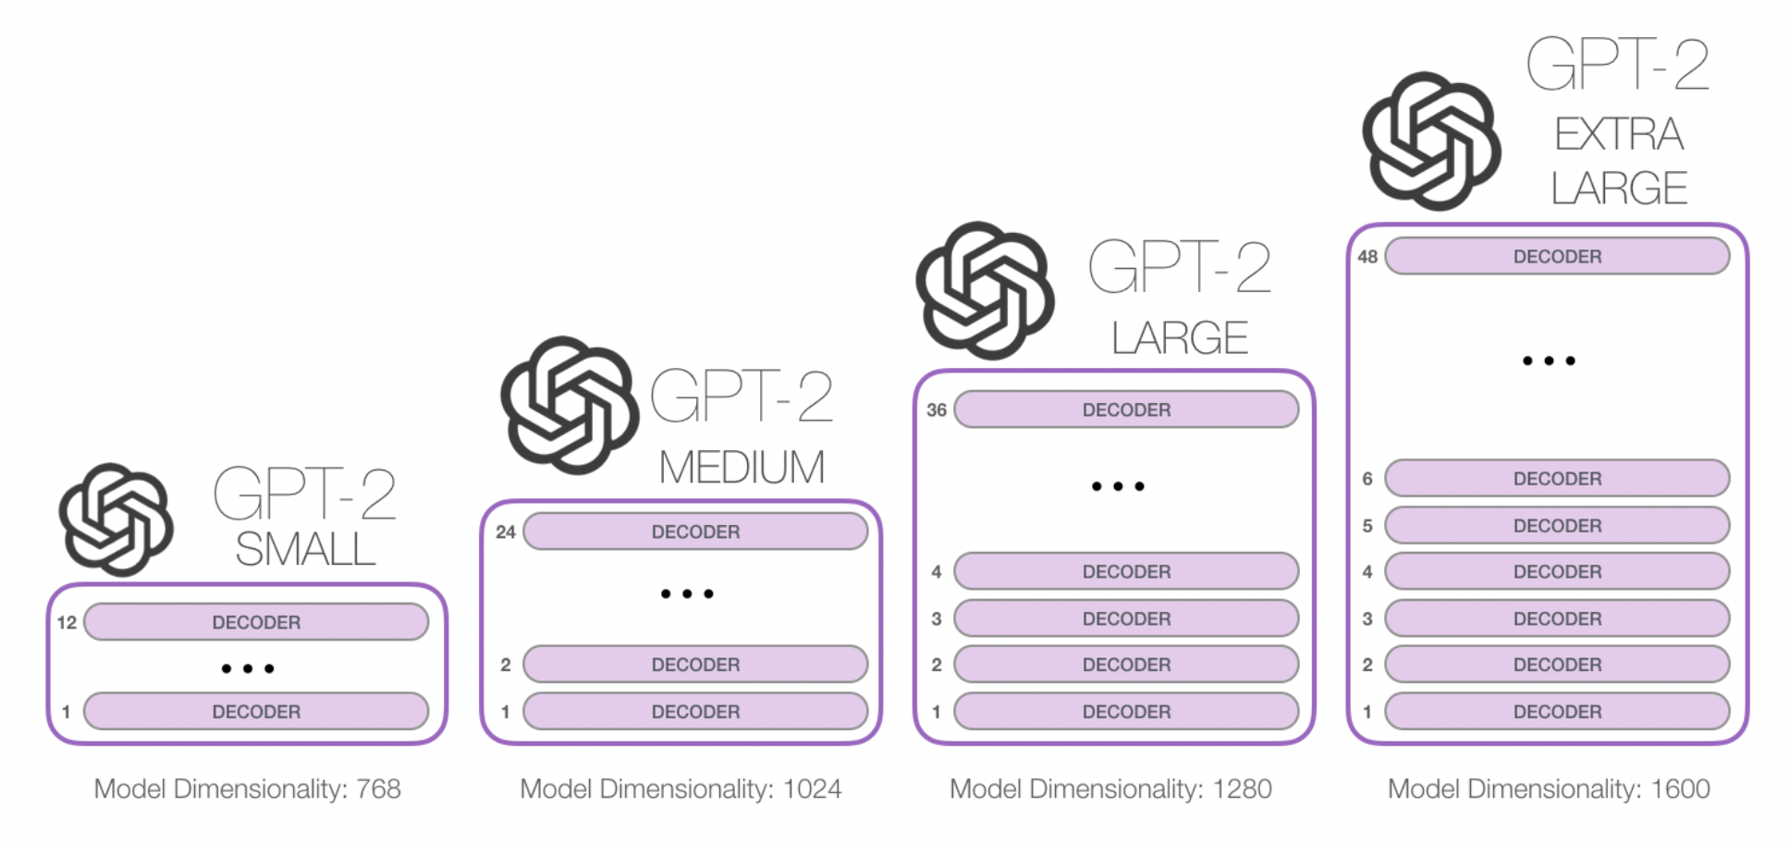
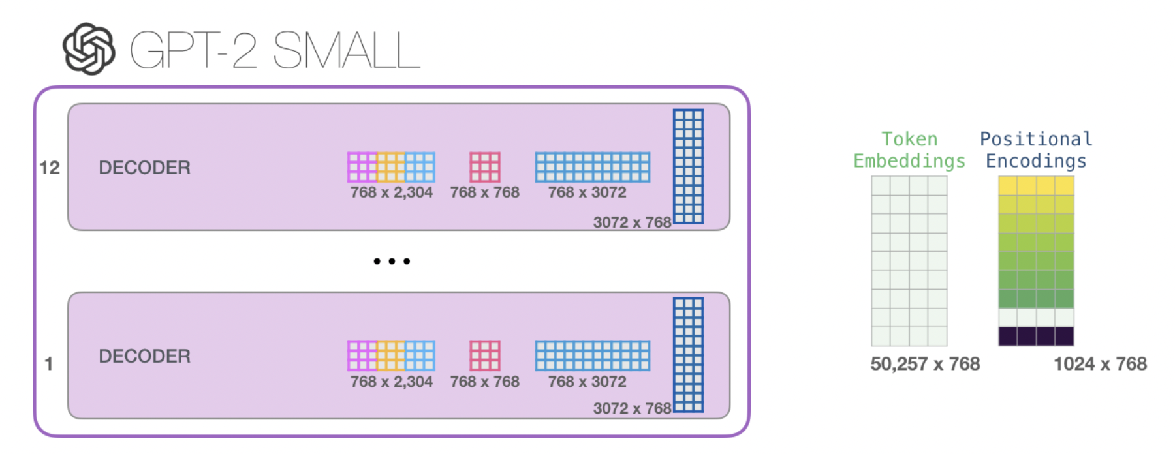
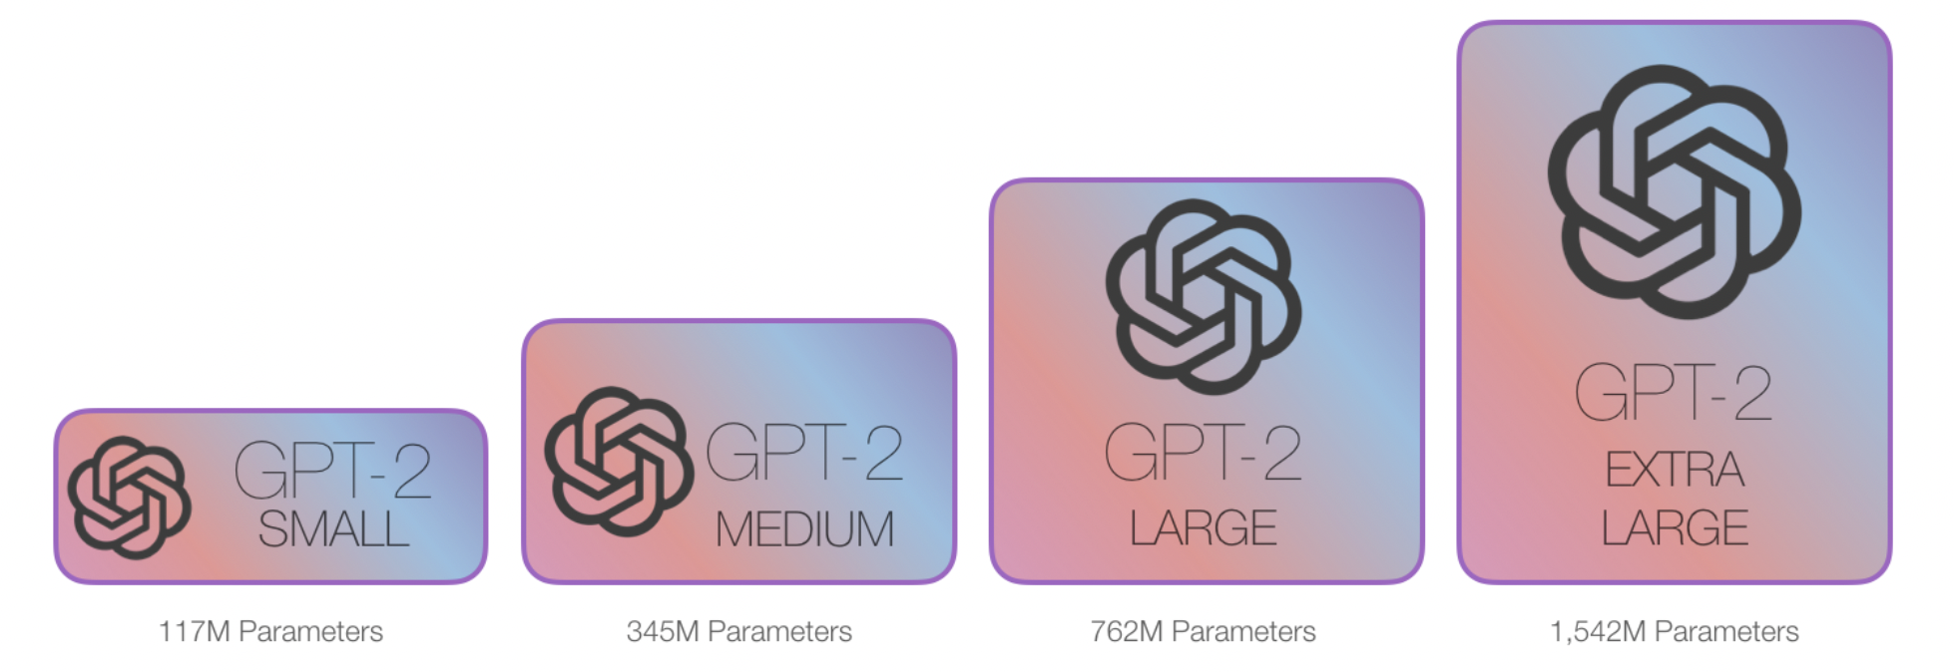
GPT2 has million (10⁶) parameters
4 different sizes: small, medium, large, extra large

Slide 13
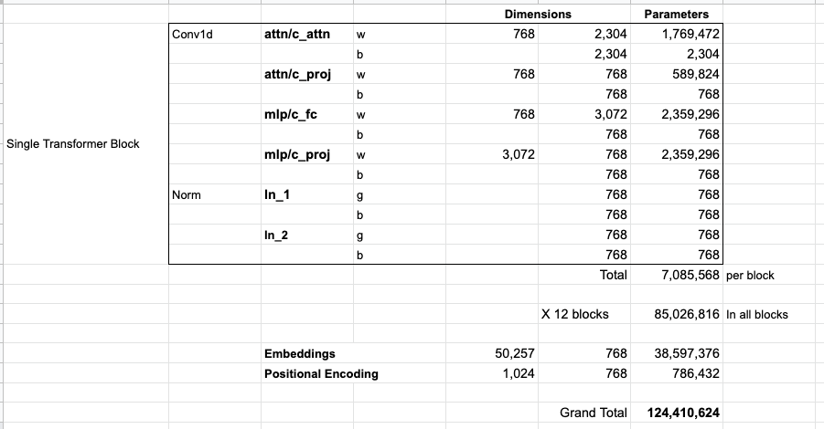
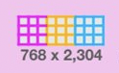
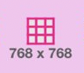
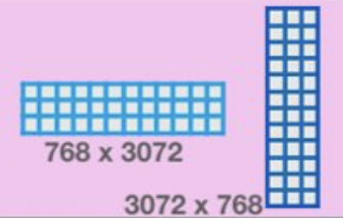
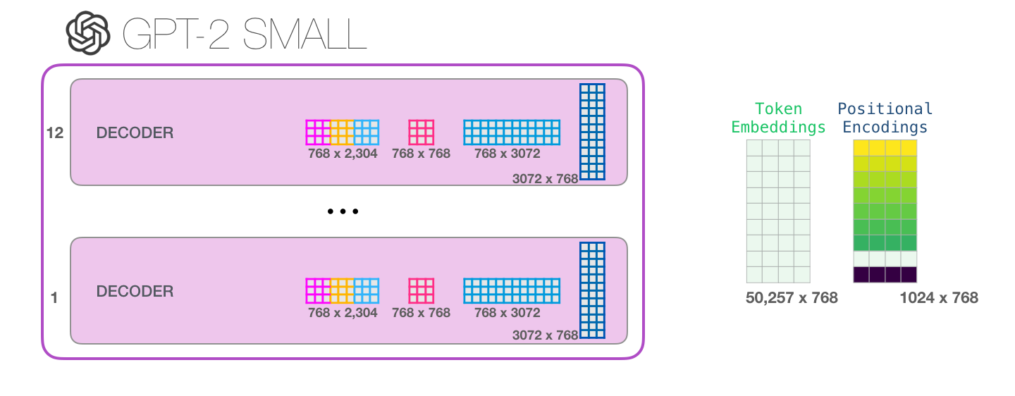
learnable parameters
small GPT2 (12-head)
Notes:
1 token embedding matrix and 1positional encoding matrix
each block has different set of 4 weight matrix:
1 Masked multi-head Self-attention layer (d_model=768)
Attention matrix: concat of query, key, value vectors, then Split into 12 attention heads
Projection matrix: turn concated self-attention output into a low-dimensional vector for FC layer
2-layer MLP
FC layer 1 (768*4 = 3072): weight matrix1
FC layer 2 (768): weight matrix2

Slide 14
Why GPT donnot need a encoder?
GPT task is language modeling, and the modified decoder architecture is sufficient to predict the next word in a sequence based on the context provided by the previous words.
The original Transformer was designed to handle sequence-to-sequence tasks just language modeling
In these tasks, the model needs to encode a given input sequence (e.g., a sentence in one language) and then decode it to generate an output sequence (e.g., a translated sentence in another language).

Slide 15
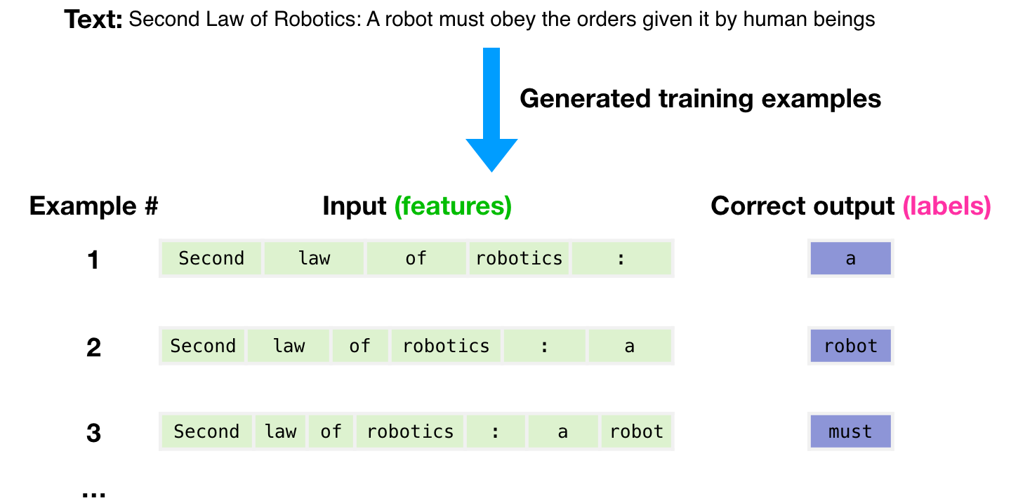
language modeling by autoregression
predict the next word based on the words that have come before
Notes:
Autoregression: Autoregression is a statistical modeling technique that predicts future values based on past values in a time series or sequence. It can be applied to various types of data, not just language. Autoregressive models can be used in language modeling, but they are not limited to this application.
Language modeling: Language modeling is a specific NLP task that involves predicting the probability distribution of the next word (or token) in a sequence, given the preceding words (or context). Language models can be autoregressive, meaning they predict the next word based on the words that have come before, but they can also employ other techniques, such as bidirectional context or masked language modeling.

Slide 16
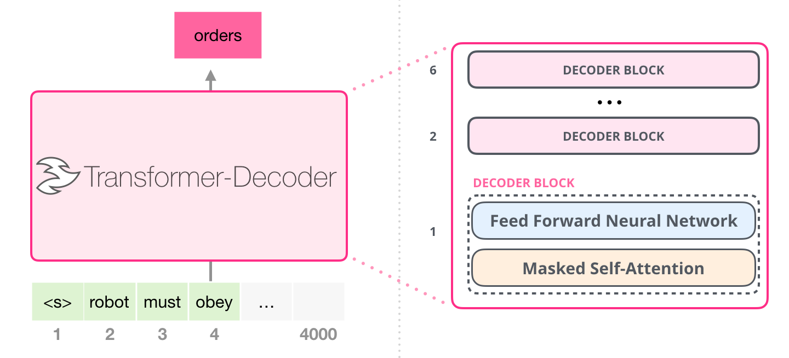
architecture: Decoder Only Block
Notes:
GPT-2 consists of multiple stacked Transformer blocks.
The number of layers varies depending on the size of the model
GPT-2-small: 12 layers, 768 hidden units, 12 attention heads, and 117M parameters.
GPT-2-medium: 24 layers, 1024 hidden units, 16 attention heads, and 345 M parameters.
GPT-2-large: 36 layers, 1280 hidden units, 20 attention heads, and 774 M parameters.
GPT-2-XL: 48 layers, 1600 hidden units, 25 attention heads, and 1.5 B parameters.
each decoder block has 2 sub-layers
masked multi-head self-attention mechanism
position-wise FC FeedForward network
positional encoding
residual connection and layer normalization

Slide 17
Why GPT donnot need a encoder?
GPT task is language modeling, and the modified decoder architecture is sufficient to predict the next word in a sequence based on the context provided by the previous words.
The original Transformer was designed to handle sequence-to-sequence tasks just language modeling
In these tasks, the model needs to encode a given input sequence (e.g., a sentence in one language) and then decode it to generate an output sequence (e.g., a translated sentence in another language).

Slide 18
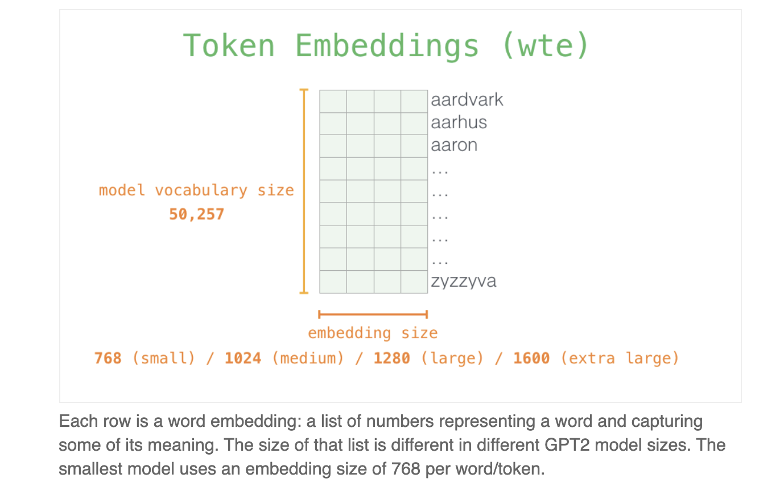
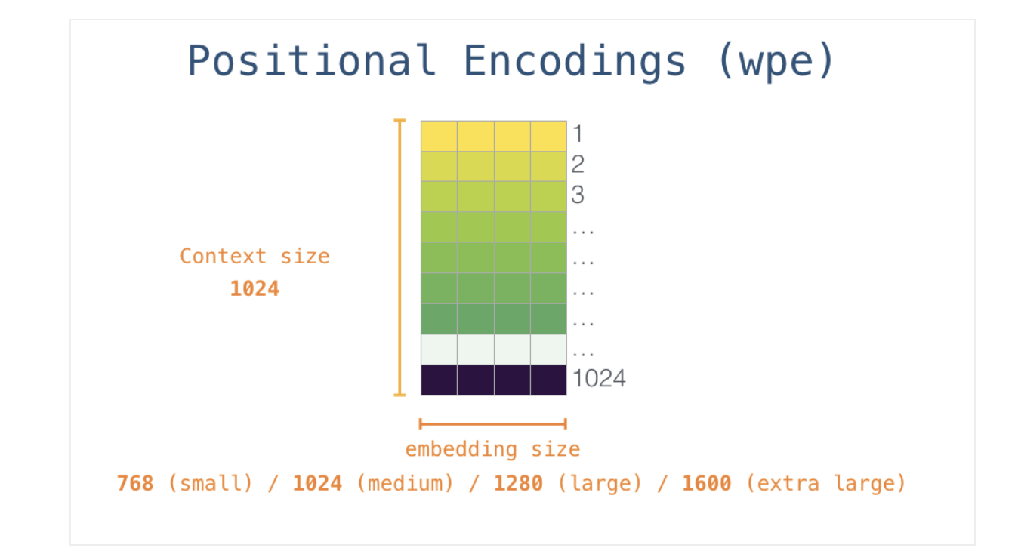
Input = token embedding + positional encoding
from pretrained model

Slide 19
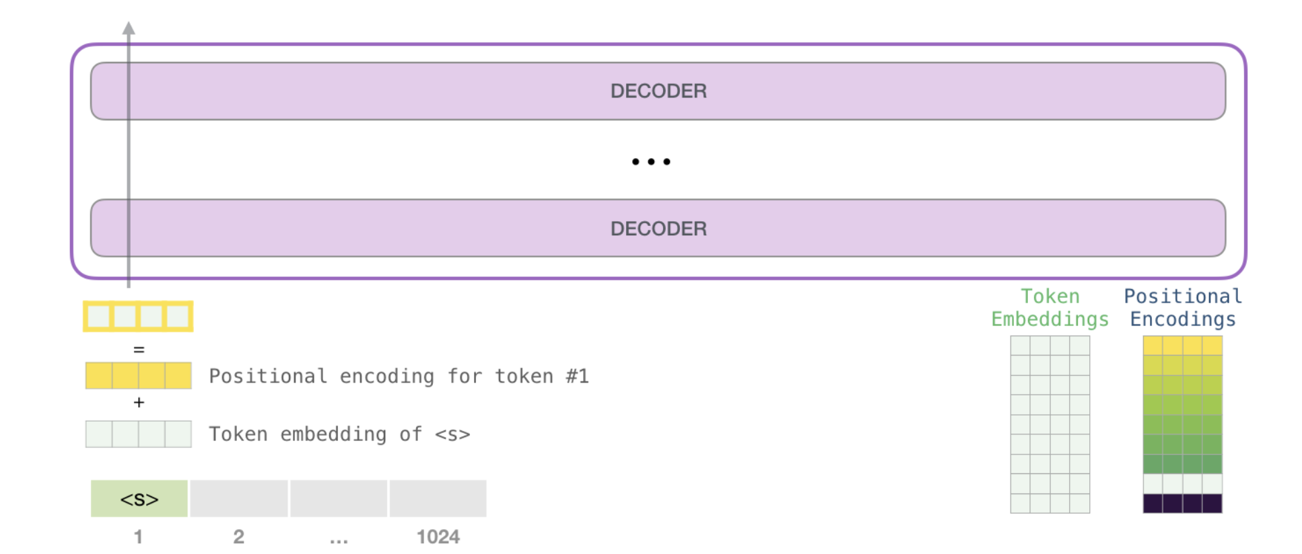
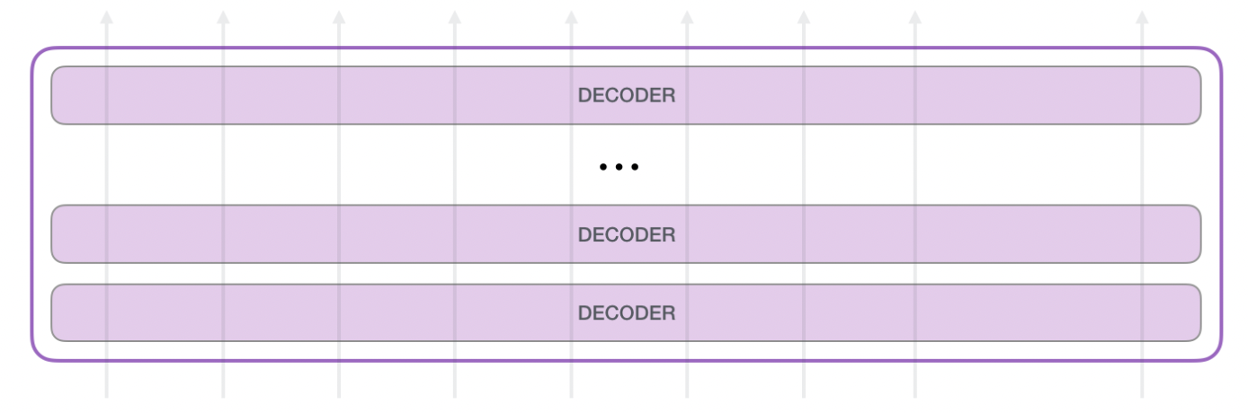

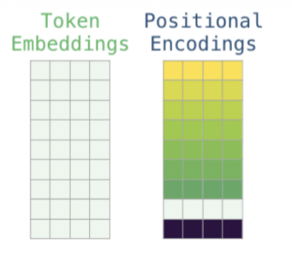

Concext size = 1024
each time, GPT-2 can process a token sequence of length 1024
Each token flows through all the decoder blocks along its own path.

Slide 20
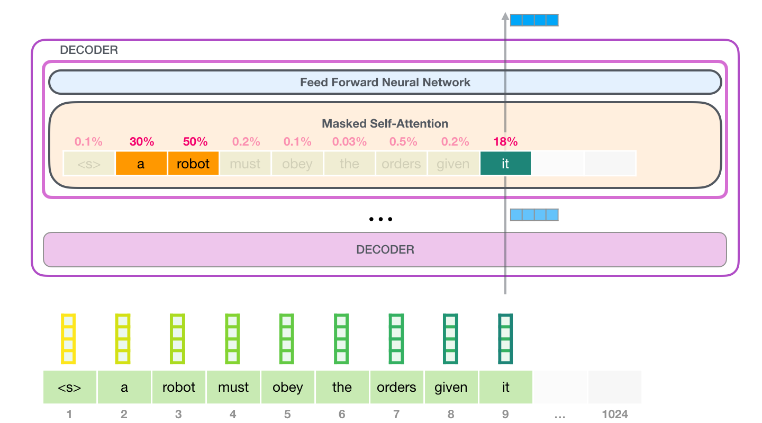
Role of self-attention: understand context
A robot must obey the orders given it by human beings except where such orders would conflict with the First Law.
e.g, before passing embedding of word “it” to Feed Forward NN
masked self-attention layer is trying to understand context of word “it” by paying attention to “ robot”
The vector it will pass to Feed Forward NN is a weighted sum of vectors for three words “a””robot””it”
current token

Slide 21
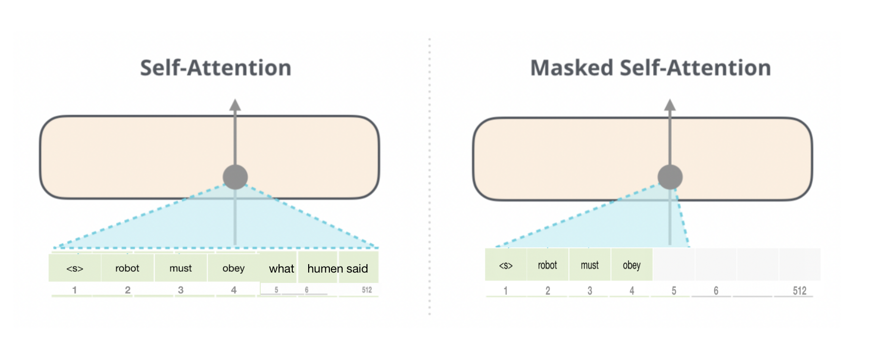
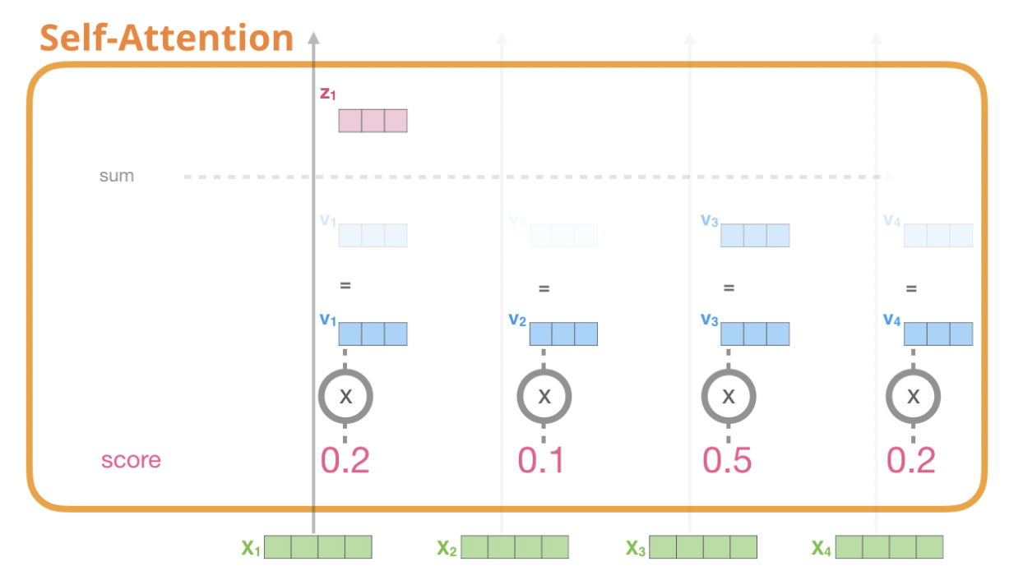
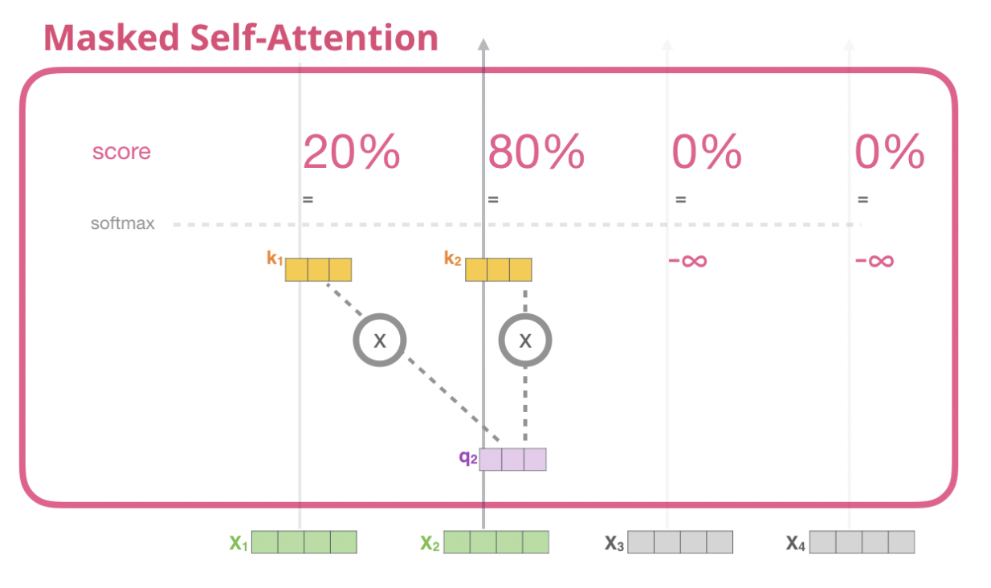
masked self-attention layer
GPT is a unidirectional language model, meaning it only attends to the left context (i.e., previous words in a sequence).
To ensure this unidirectional context, GPT employs masked self-attention, which prevents the model from looking at future words when predicting the next word in a sequence.

Slide 22
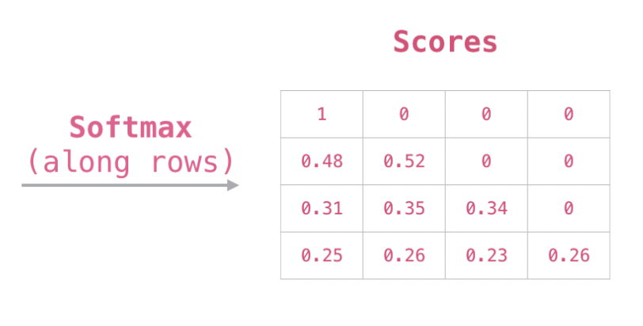
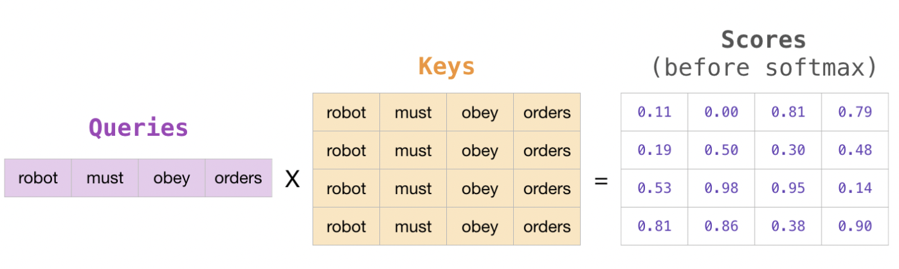
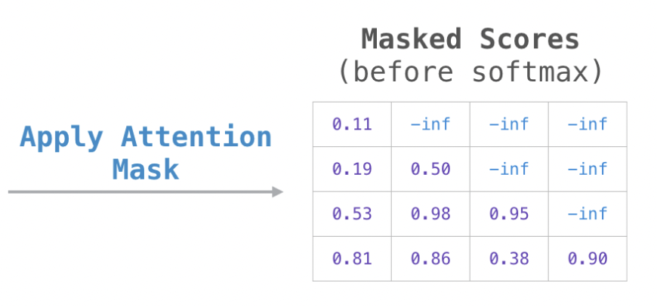
masked self-attention
Attention mask matrix: set the cells we want to mask to -infinity or a very large negative number (e.g. -1 billion in GPT2)
When model processes first token “robot" (row #1), 100% attention will on that word “robot"
When model processes 2nd token “must” (row #2), 48% attention will on “robot”, 52% will be “must”.

Slide 23
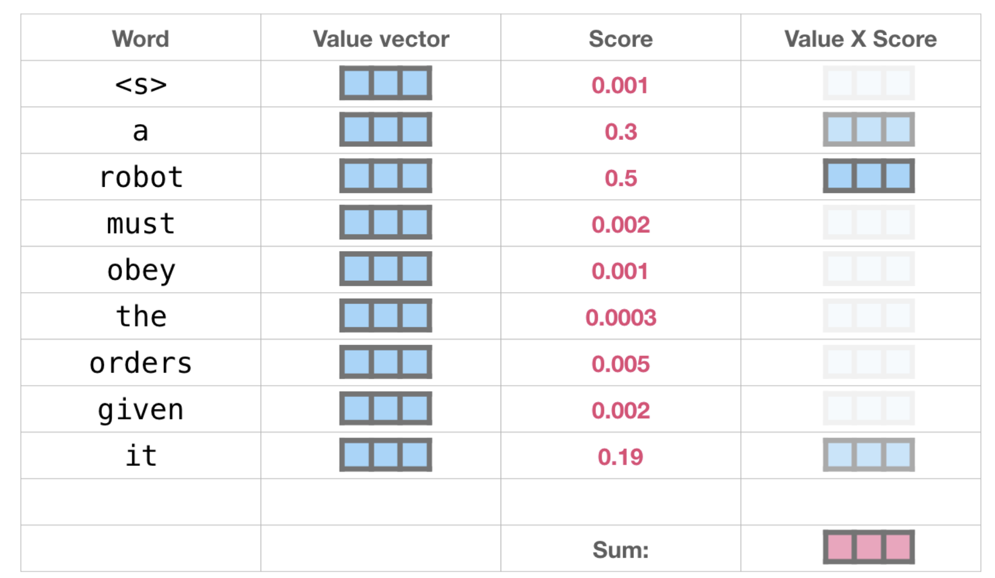
calculate self-attention output
multiply each value vector by its score and sum up -> self-attention output

Slide 24
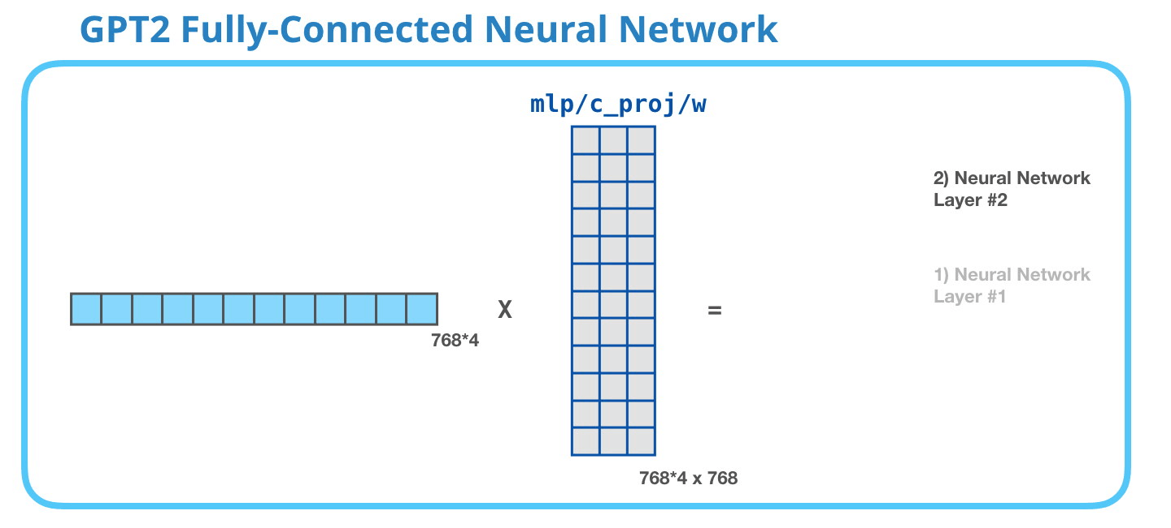
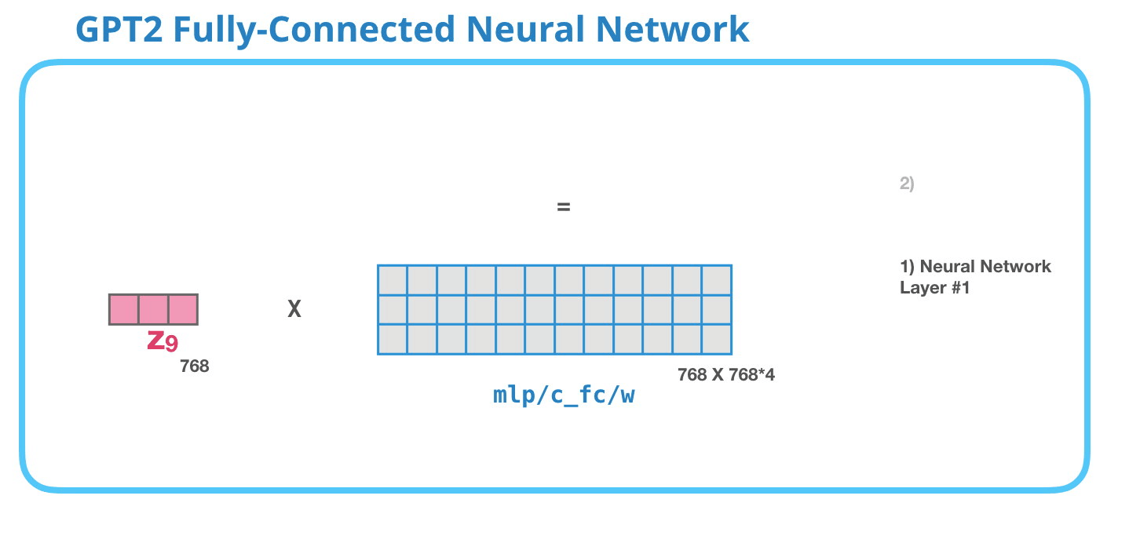
Position-wise FC Feedforward layer: 2-layer MLP
Output layer (768): Y = ZW2+b
first layer (768*4): H = ZW1+b
Input (768): Z

Slide 25
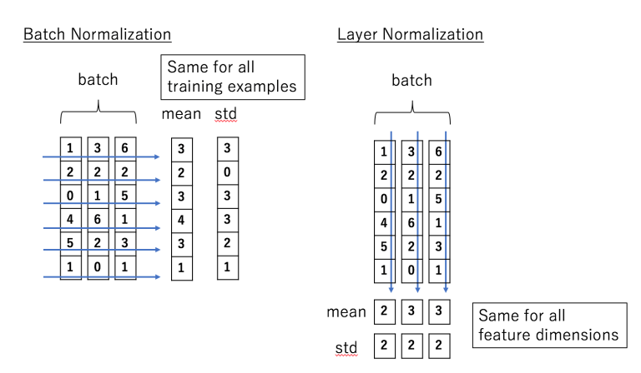
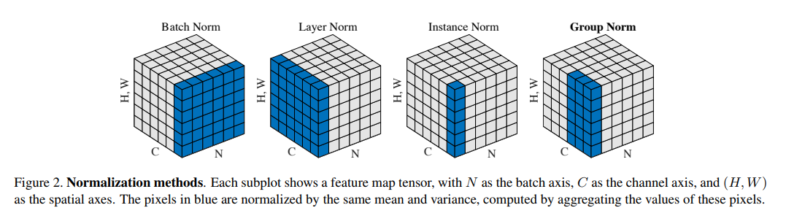
layer normalization

Slide 26
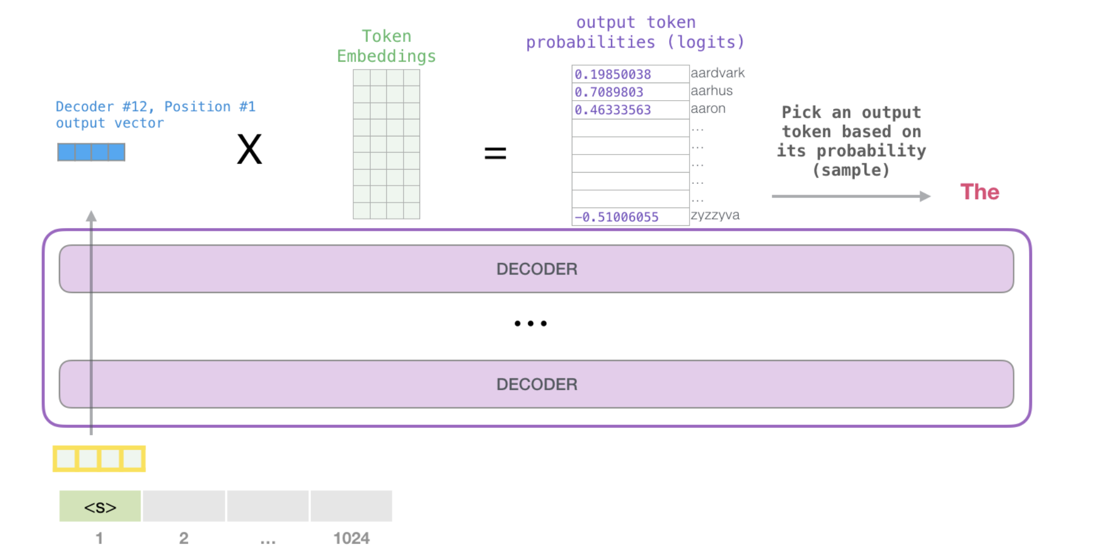
Output
set top_k = 40, sample a word from 40 words of highest scores using score as probability (so words with a higher score have a higher chance of being selected)
The model continues iterating until the entire context is generated (1024 tokens) or produce an [EOS] token
input <s>, output a single word ‘The’
projection matrix

Slide 27
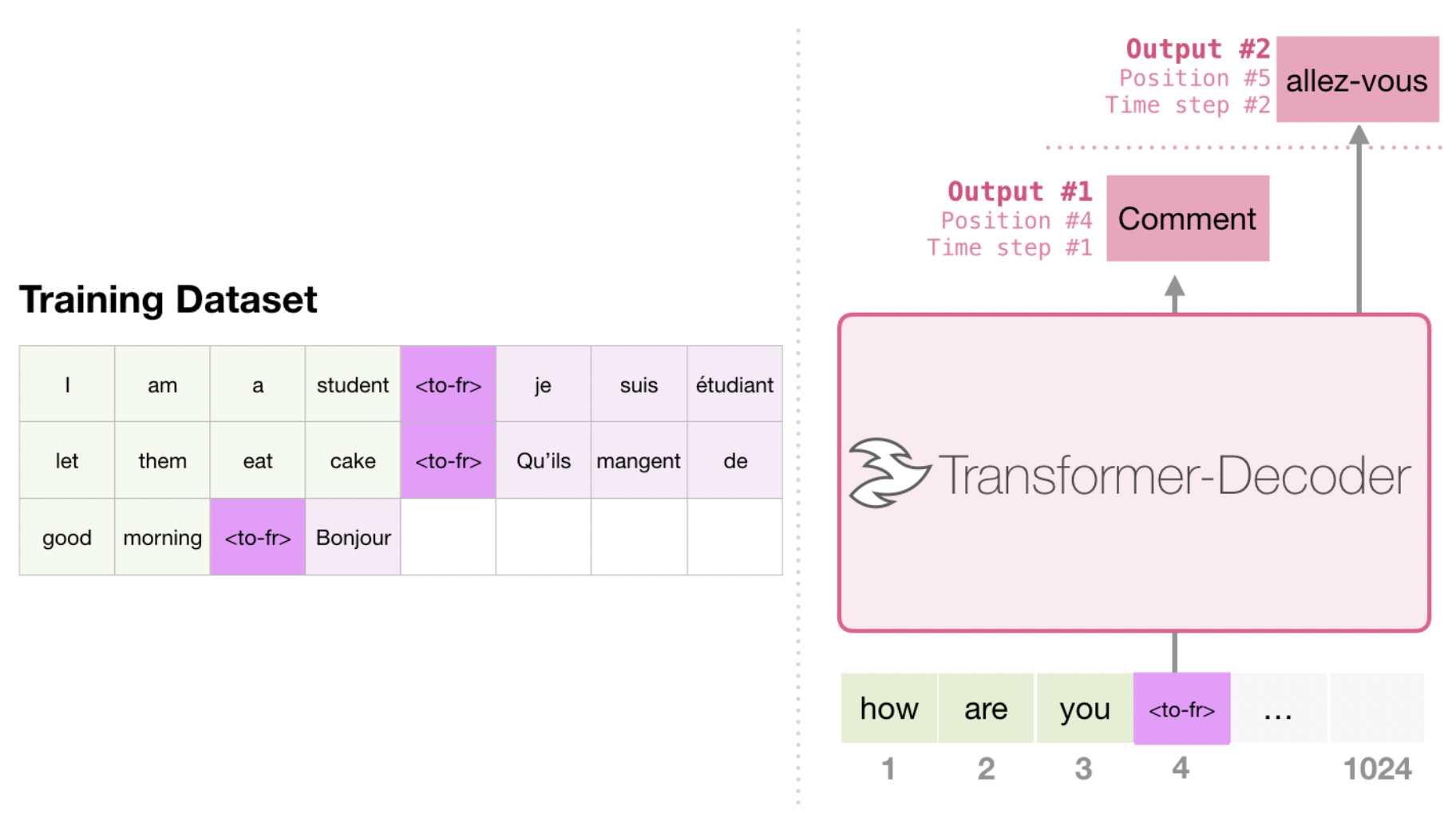
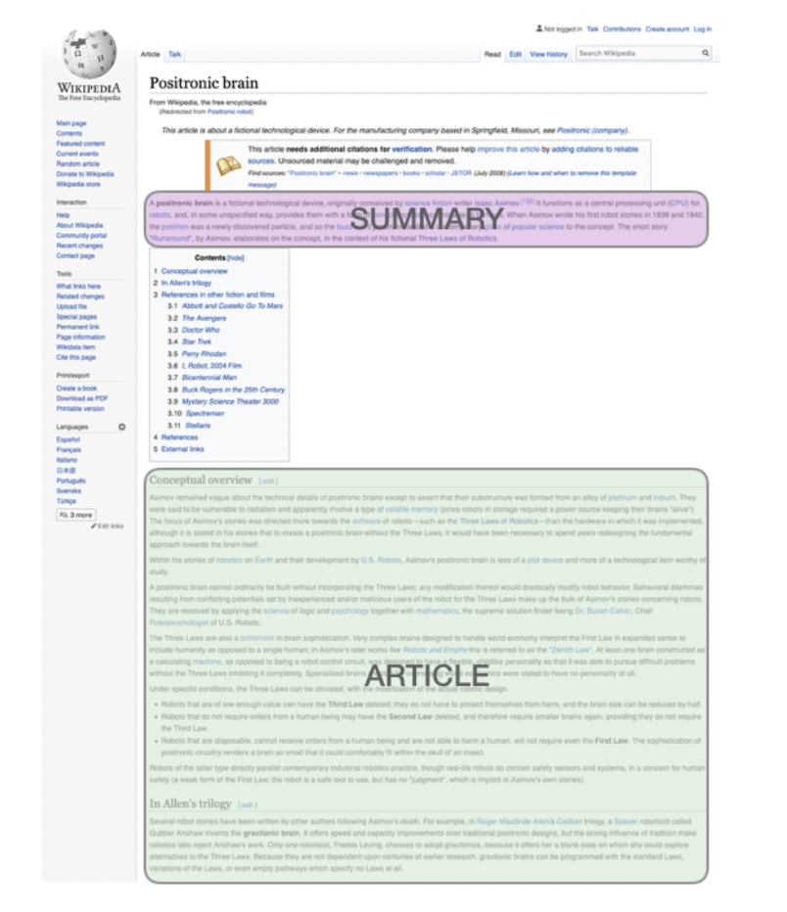
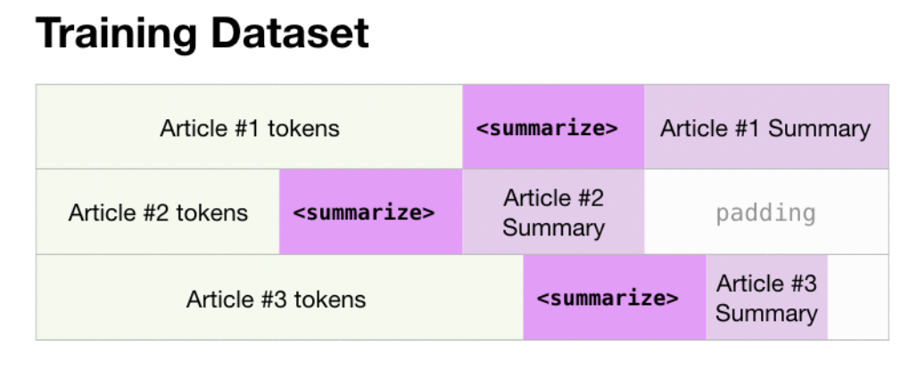
Supervised fine-tuning on specific task
Machine translation
Summarization

Slide 28

MuseNet-Music Generator uses GPT2
Starts with a music token and generates next token in
Sequence
Tokens contain information on:
1. pitch,
2. volume,
3. Instrument
Trained on a large archive of MIDI files
https://openai.com/blog/musenet/

Slide 29
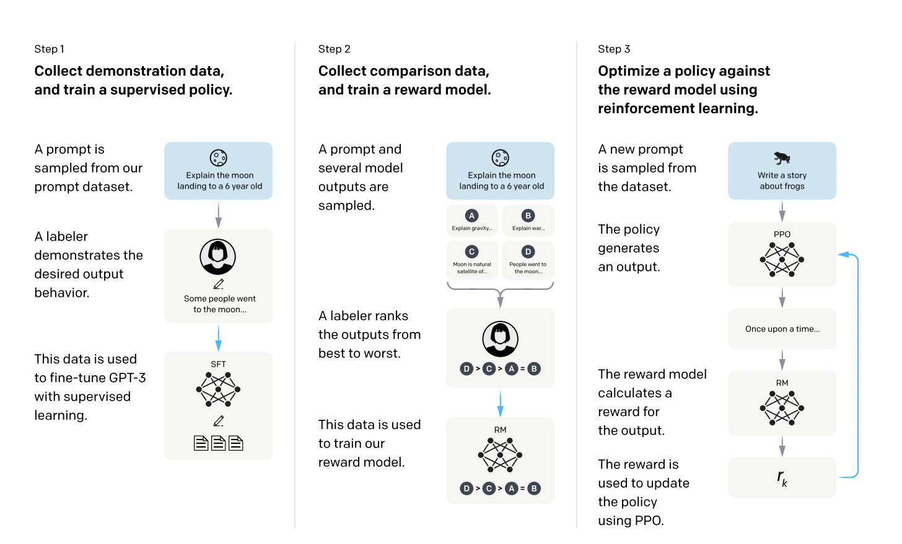
GPT3.5 (InstructGPT) = instruction fine-tuning on 30k tasks + RLHF
RLHF reinforcement learning with human feedback
human feedback can be provided in various forms
rewarding or punishing the model's actions,
providing labels for unlabeled data
adjusting model parameters

Slide 30
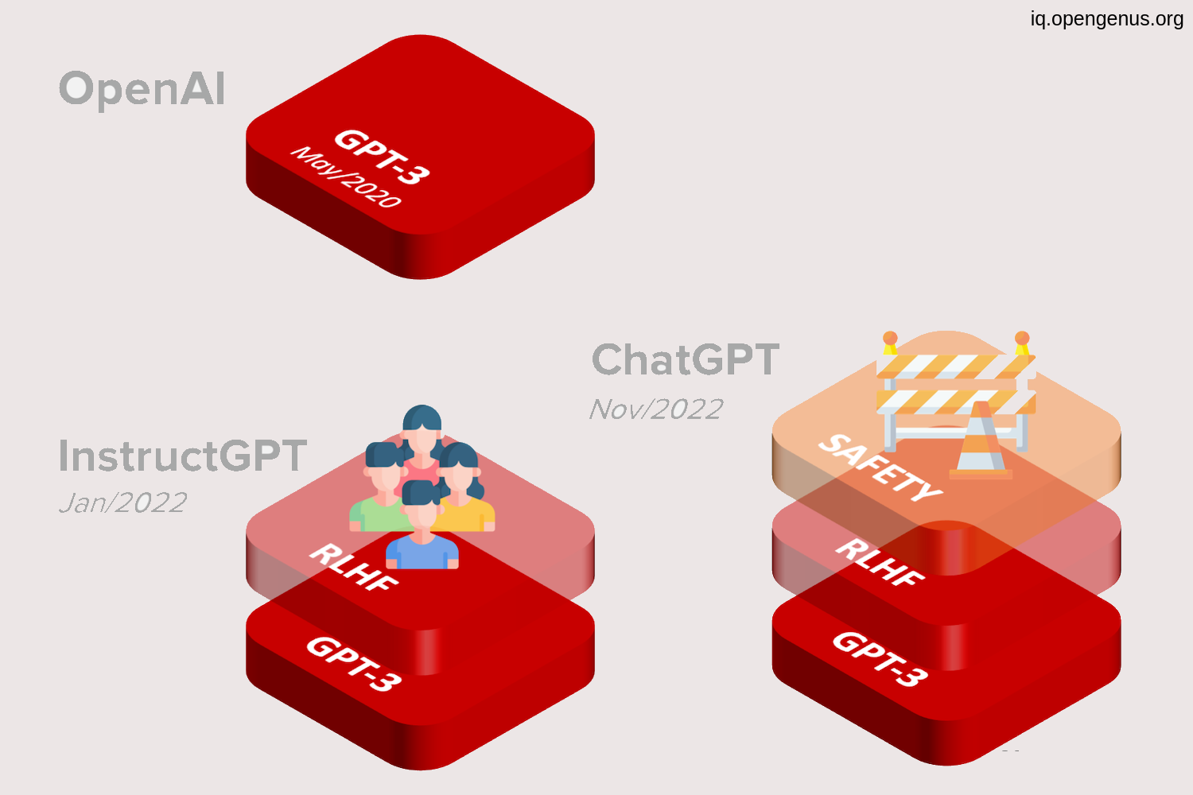
ChatGPT = instruction fine-tuning on QA task

